Slide 1

G
R
E
E
N
G
A
I
T
Notes:
Superteam Deck Notes: Put your startup name and logo with a 1-line subtitle.
This subtitle should be a game changer - it focuses on outcomes and the secret sauce.
(eg. “Decentraland - a virtual world owned by its users”)

Slide 2


G
E
N
R
E
G
I
A
T
Move to earn, live to sustain
powered by motion, secured by blockchain
Notes:
Superteam Deck Notes: Put your startup name and logo with a 1-line subtitle.
This subtitle should be a game changer - it focuses on outcomes and the secret sauce.
(eg. “Decentraland - a virtual world owned by its users”)

Slide 3







Table of contents
G
R
E
E
N
1
6
Ask & Call to Action
Vision & Opportunity
One-Liner
Problem & Vision
Market Opportunity
GTM & Why Now?
Next Steps
Future Collaboration
Contact Us
G
I
A
T
2
5
Roadmap & Risk
Team & Edge
Team
Competitors
Traction
Roadmap
Risks & Mitigation
3
4
Product & Engineering
Business Model & Monetization
Hackathon Engineering Sprint
Demo Architecture
Live Demo
Revenue
Terms
Impact
GreenGait
Notes:
Superteam Deck Notes: Put your startup name and logo with a 1-line subtitle.
This subtitle should be a game changer - it focuses on outcomes and the secret sauce.
(eg. “Decentraland - a virtual world owned by its users”)

Slide 4
GreenGait is a revolutionary and innovative platform that empowers people to turn movement into real-world impact — move to earn, live to sustain, powered by motion, secured by blockchain.
GreenGait
01
Notes:
Superteam Deck Notes: Put your startup name and logo with a 1-line subtitle.
This subtitle should be a game changer - it focuses on outcomes and the secret sauce.
(eg. “Decentraland - a virtual world owned by its users”)

Slide 5
Vision & Opportunity
The Problem
🛑 76% of people do not meet the minimum recommended physical activity levels — wasting hours weekly that could contribute to both personal health and environmental impact. WHO reports that 1 in 3 adults is physically inactive, costing over $54 billion/year in preventable healthcare expenses.
⚠️ 83% of sustainability leaders report that current engagement tools fail to connect people’s daily behavior with real ESG value — leaving a huge opportunity gap.
🧠 Wars, pandemics, and blackouts reveal how fragile and dependent our energy systems truly are — leaving millions vulnerable.
📊 People want to live healthier and greener lives — but without incentives or feedback, behavior change doesn't last. Our MVP validated that real-time rewards spark motivation and traction.
% Inactive Adults
35%
30%
26%
2010
2020
2030
GreenGait
01
Notes:
Superteam Deck Notes: Put your startup name and logo with a 1-line subtitle.
This subtitle should be a game changer - it focuses on outcomes and the secret sauce.
(eg. “Decentraland - a virtual world owned by its users”)

Slide 6






Vision & Opportunity
The Vision
🦶 Move to earn. Every physical step becomes a tokenized reward by turning walking into real-world value.
♻️ Live to sustain. We empower healthier lifestyles and greener choices through gamified eco-incentives.
🔐 Built for trust. Secured by blockchain, powered by real motion — GreenGait makes sustainable
action transparent and tamper-proof.
🛠️ Our Big Vision We imagine a world where walking powers wellness, shopping funds reforestation, and movement drives climate action.
GreenGait is not just a product, it's the engine of a decentralized movement economy.
GreenGait Impact Loop
GreenGait
01
Notes:
Superteam Deck Notes: Put your startup name and logo with a 1-line subtitle.
This subtitle should be a game changer - it focuses on outcomes and the secret sauce.
(eg. “Decentraland - a virtual world owned by its users”)

Slide 7

Vision & Opportunity
Market Opportunity
We’re unlocking value at the intersection of three booming industries:
💪$160B+ Wearable Fitness Market: By 2028, the wearable tech market is expected to exceed $160 billion — people are investing more than ever in health-tracking tools.
🪙 Blockchain Rewards Are Reshaping Behavior: Token-based incentives are transforming how we engage users. Movement is now a monetizable behavior, not just a health stat.
🌿 Green Lifestyle Spending is Soaring: Gen Z and Millennials are spending more on eco-conscious products. ESG-focused brands are searching for better user engagement tools.
💡 The Insight Investors Miss: Your daily steps are worth more than calories burned. They are untapped economic and energy-generating micro-actions.
🚀 GreenGait = New Category Creator: We combine physical movement, energy harvesting, and tokenized sustainability. Every step becomes a rewardable, trackable, and valuable action.
A 100x Opportunity at the Intersection of Health, Crypto, and Climate
GreenGait
01
Notes:
Superteam Deck Notes: Put your startup name and logo with a 1-line subtitle.
This subtitle should be a game changer - it focuses on outcomes and the secret sauce.
(eg. “Decentraland - a virtual world owned by its users”)

Slide 8

Vision & Opportunity
GTM & Why Now?
Go-To-Market Strategy
🎯 Target Segments: Eco-conscious users, fitness student groups, and early crypto adopters.
🧪 Closed Beta: Launch MVP with wearable prototype + onboarding portal.
🤝 Partnerships: Collaborate with eco brands & local gyms for real-world rewards.
🪙 Token Launch: Deploy on Solana mainnet with marketplace rewards.
🧩 Gamification: Add quests, leaderboards, and social step challenges.
Why Now?
💪 Move-to-Earn Momentum: Consumers want real rewards for physical effort.
🌱 Sustainability Pressure: Corporates & users seek eco-responsible alternatives.
📲 Wearables Boom: Smart devices are now widely used and data-rich.
🧑‍💻 Crypto-native Gen Z: They want purpose-driven apps that are decentralized and rewarding.
💡 "GreenGait sits at the perfect storm of these macrotrends — and is ready to ride the wave."
GreenGait
01
Notes:
Superteam Deck Notes: Put your startup name and logo with a 1-line subtitle.
This subtitle should be a game changer - it focuses on outcomes and the secret sauce.
(eg. “Decentraland - a virtual world owned by its users”)

Slide 9
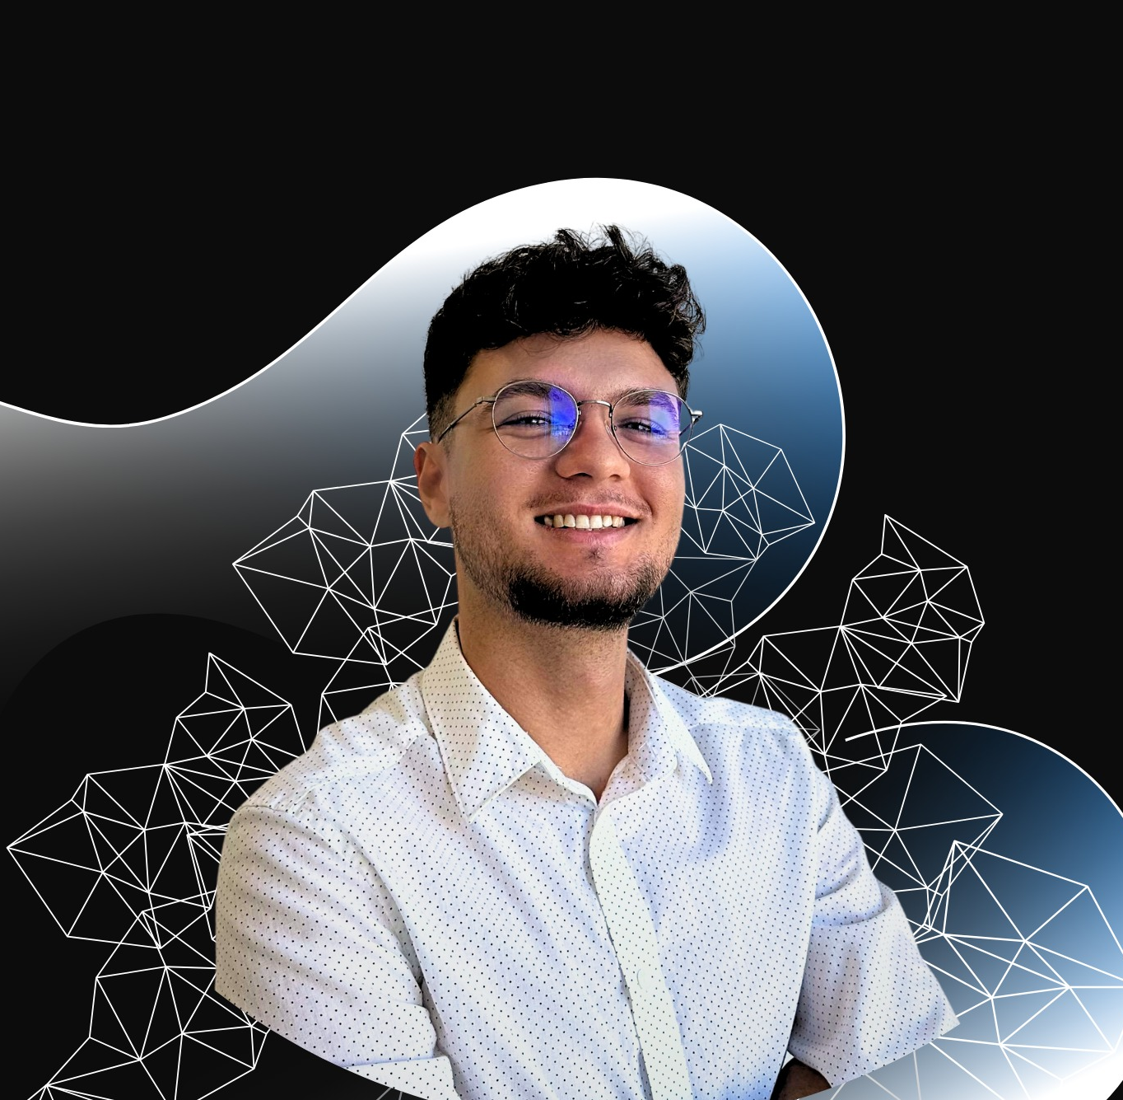
Team & Edge
Team
🎓 Credentials: Cybersecurity MSc | Researcher in Green Energy Systems | Blockchain Developer
🛠️ Built From Scratch: Designed, coded, and deployed the entire GreenGait MVP
💡 Why Me: “Founder with deep-tech expertise across IoT, blockchain, and sustainability — building with purpose and speed.”
🔮Planned Talent Pipeline: I’ve already identified key collaborators and technical talent to join the GreenGait journey post-selection — ensuring we scale with trust and aligned vision.
Robert Panța
Founder & Builder
GreenGait
02
Notes:
Superteam Deck Notes: Put your startup name and logo with a 1-line subtitle.
This subtitle should be a game changer - it focuses on outcomes and the secret sauce.
(eg. “Decentraland - a virtual world owned by its users”)

Slide 10






Team & Edge
Competitors
STEPN
Sweatcoin
Apple Health
Pacer
Barrier-Free
Energy Harvesting
Blockchain Rewards
Eco Incentives
GreenGait
02
Notes:
Superteam Deck Notes: Put your startup name and logo with a 1-line subtitle.
This subtitle should be a game changer - it focuses on outcomes and the secret sauce.
(eg. “Decentraland - a virtual world owned by its users”)

Slide 11
Team & Edge
Traction
✅ Prototype Built Fast: Fully functional MVP developed using ESP32 + secure onboarding via captive Wi-Fi portal.
🔐 Secure Backend Live: Deployed using Rust, mutual TLS, and HMAC to log steps on Solana.
🪙 Real-Time Rewards: Steps convert into tokens (every X steps = 1 token), live on dashboard.
👀 Early Interest: Peers, mentors, and hackathon organizers have shown strong enthusiasm for the platform’s real-world potential.
📈 Full End-to-End Cycle: Hardware interaction → secure validation → blockchain reward → user dashboard — all operational on Devnet.
GreenGait
02
Notes:
Superteam Deck Notes: Put your startup name and logo with a 1-line subtitle.
This subtitle should be a game changer - it focuses on outcomes and the secret sauce.
(eg. “Decentraland - a virtual world owned by its users”)

Slide 12

Product & Engineering
Hackathon Engineering Sprint
🛠️ What We Prioritized We focused on building a secure, end-to-end prototype that validates our full value loop:
👣 Physical motion → 🔐 Secure transmission → 🪙 On-chain minting → 📲 Real-time feedback
🔒 Tech Stack Choices
ESP32 for physical input
Mutual TLS + HMAC for secure step validation
Solana smart contracts for tokenization
💡 What We Learned
Users respond to instant rewards
Secure onboarding (via captive portal) is critical
Full-cycle validation gives investor confidence in scalability and real-world adoption
GreenGait
03
Notes:
Superteam Deck Notes: Put your startup name and logo with a 1-line subtitle.
This subtitle should be a game changer - it focuses on outcomes and the secret sauce.
(eg. “Decentraland - a virtual world owned by its users”)

Slide 13
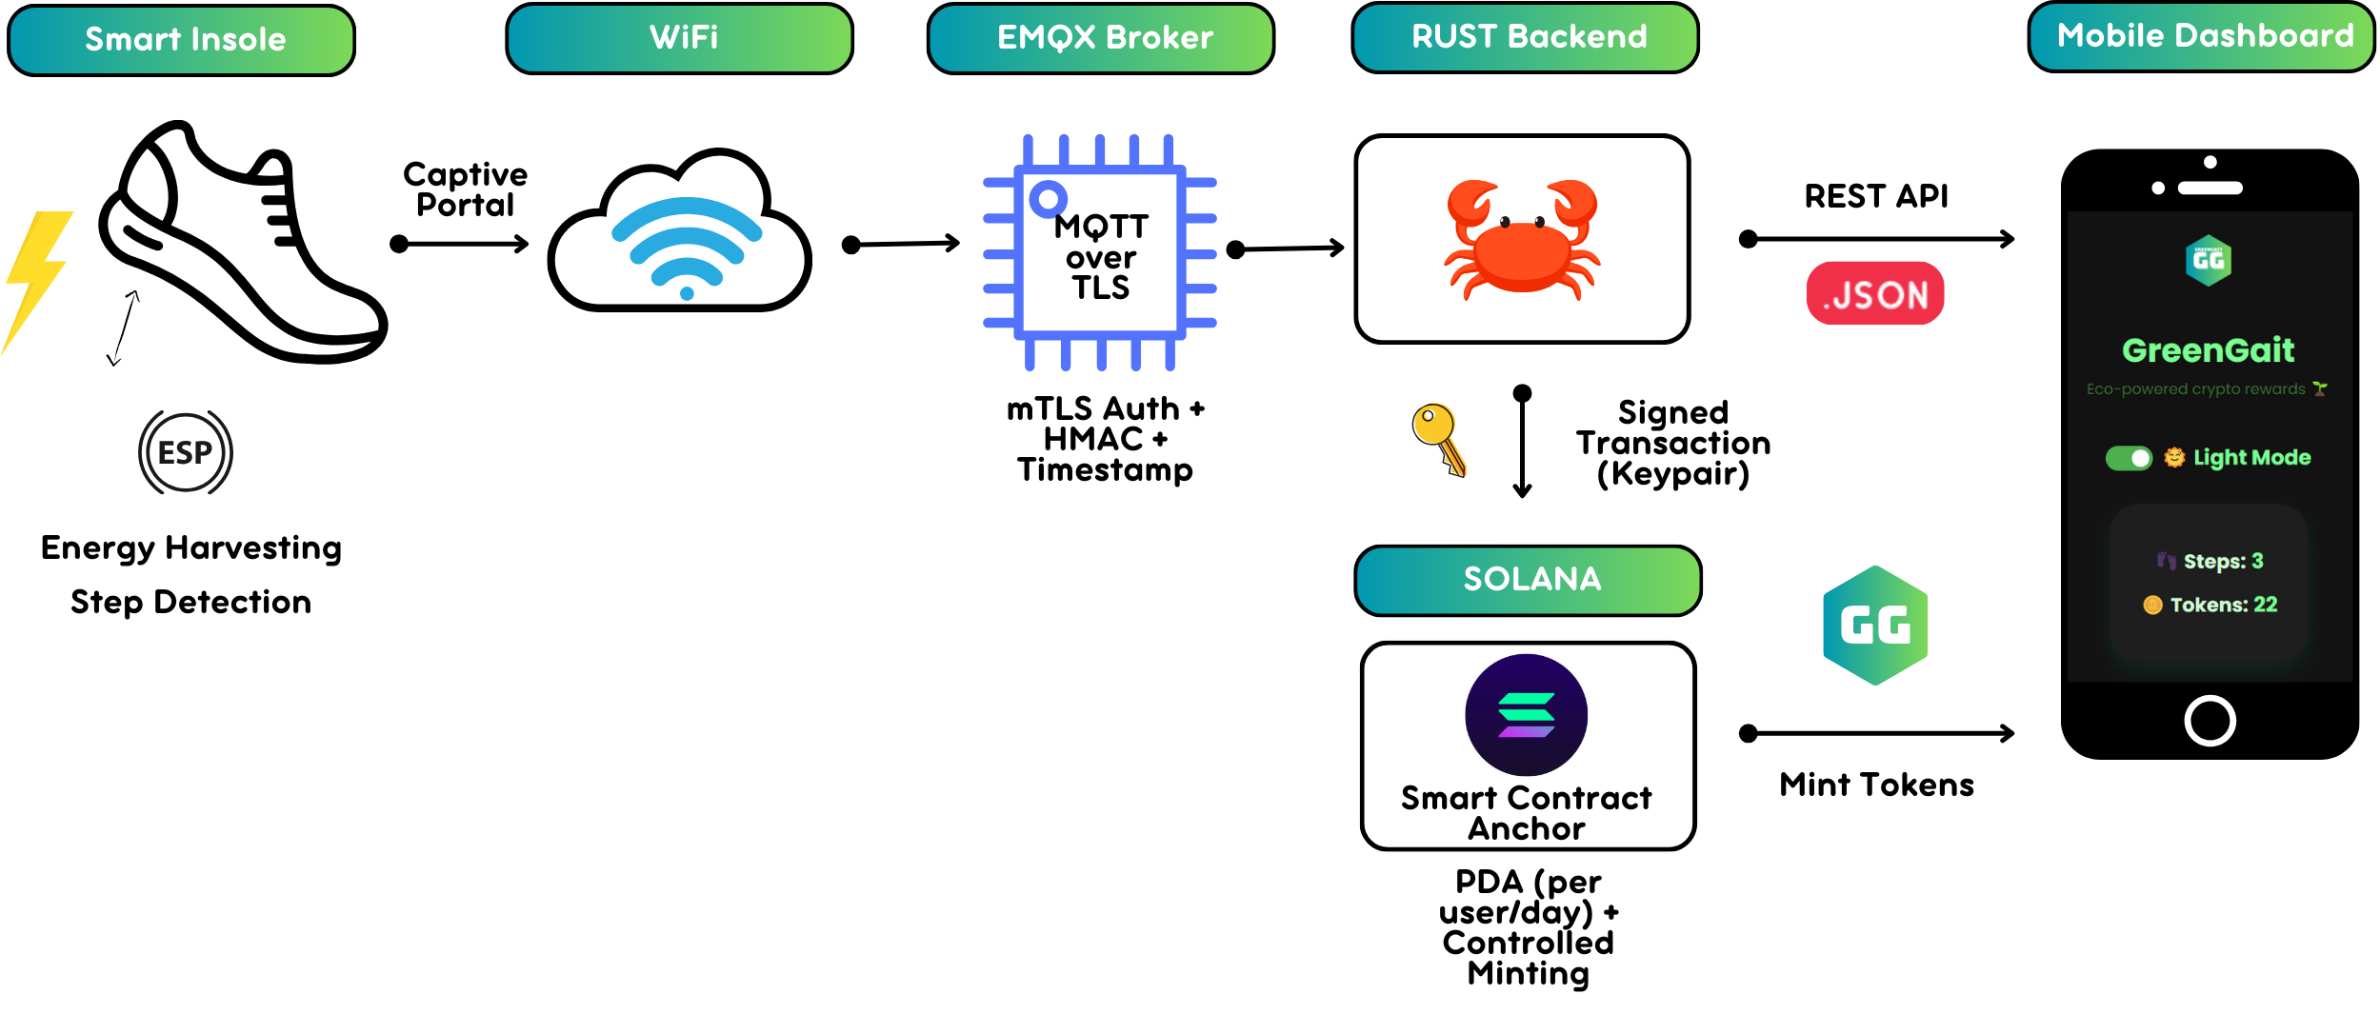
Product & Engineering
Demo Architecture
GreenGait
03
Notes:
Superteam Deck Notes: Put your startup name and logo with a 1-line subtitle.
This subtitle should be a game changer - it focuses on outcomes and the secret sauce.
(eg. “Decentraland - a virtual world owned by its users”)

Slide 14


Product & Engineering
Live Demo
GreenGait
03
Notes:
Superteam Deck Notes: Put your startup name and logo with a 1-line subtitle.
This subtitle should be a game changer - it focuses on outcomes and the secret sauce.
(eg. “Decentraland - a virtual world owned by its users”)

Slide 15

Business Model & Monetization
Revenue
9% Q1
🌐 Token Ecosystem & Fees:
Micro-fees on token minting, transfers, and rewards.
🛒 Marketplace Commissions:
% from eco brands and gyms offering sustainable products/services.
📦 B2B Licensing:
White-label GreenGait for corporate wellness & ESG initiatives.
✨ Premium Subscriptions:
Team challenges, health analytics, early reward access.
🤝 Brand Sponsorships & Green Tax Credits:
Brands fund eco-challenges and carbon-offset campaigns using GG tokens.
🪙 GreenGait isn’t just generating revenue, it’s turning footsteps into a new form of capital.
income increase/quarter
50K
16% Q2
Revenue (€)
income increase/quarter
30K
10K
Users
22% Q3
0K
income increase/quarter
27% Q4
income increase/quarter
GreenGait
04
Notes:
Superteam Deck Notes: Put your startup name and logo with a 1-line subtitle.
This subtitle should be a game changer - it focuses on outcomes and the secret sauce.
(eg. “Decentraland - a virtual world owned by its users”)

Slide 16
Business Model & Monetization
Terms
We’re raising €50,000 pre-seed
💸 In exchange, we offer:
10% equity in GreenGait
⚖️ Optional token allocation bonuses for early backers
What it funds:
Finalizing the energy-harvesting wearable
Expanding our closed beta in eco/fitness communities
Launching GG token on Solana Mainnet
Integrating reward marketplace partners
By supporting us early, you gain:
🎯 Early exposure in the emerging “Move-to-Earn” + climate-tech economy
📢 Visibility across eco-conscious, crypto-native users
🔗 A path to active advisory or token utility integration
🌍 Potential brand alignment on public-facing platforms and campaigns
💡 With world-side investors and judges early alignment with GreenGait offers not just return potential — but positioning at the frontier of Web3 x Wellness x Climate.
GreenGait
04
Notes:
Superteam Deck Notes: Put your startup name and logo with a 1-line subtitle.
This subtitle should be a game changer - it focuses on outcomes and the secret sauce.
(eg. “Decentraland - a virtual world owned by its users”)

Slide 17
Business Model & Monetization
Impact
🌱 10M steps = 1,000+ trees planted (gamified eco campaigns)
💪 84% of beta users increased daily activity
🪫 +28% energy harvested from walking vs. previous models
♻️ Every 100 tokens = 1 kg CO₂ offset (via partners)
GreenGait is built to make every step count — not just physically, but environmentally and socially.
We don't rely on extractive monetization — we create value through:
✅ Behavior change → healthier users
✅ ESG alignment → partners fund climate actions
✅ Token utility → drives marketplace volume
✅ Community challenges → organic virality and retention
Our impact isn’t a byproduct — it’s a core driver of adoption, revenue, and retention.
GreenGait
04
Notes:
Superteam Deck Notes: Put your startup name and logo with a 1-line subtitle.
This subtitle should be a game changer - it focuses on outcomes and the secret sauce.
(eg. “Decentraland - a virtual world owned by its users”)

Slide 18


Roadmap & Risk
Roadmap
Phase I: ⏳ Next 6 Months – MVP Validation & Early Adoption
Phase II: 🚀 Next 18 Months – Growth & Monetization
Phase III: 🌍 Next 36 Months – Visionary Expansion
Launch open beta + mobile app (iOS & Android)
Launch Wearable v1 with piezo/solar energy harvesting
Get GG Token accepted in ESG programs as “green credits”
Expand to smart insole wearable version
Launch charging stations at gyms/events powered by user energy
Deploy GreenGait Token on Solana Mainnet
Track real-time energy & battery stats on-chain
Integrate with national fitness & sustainability programs
Run closed beta with university fitness groups & eco communities
Forge strategic partnerships with gyms, wellness platforms, and eco brands
Release Marketplace v1 with pilot brand partners
Global leaderboards & real-world prize challenges
Release Tokenomics v2 + pilot DAO governance
Become the global standard for movement-based green incentives
Add gamified features: step goals, quests, leaderboards
Go live with revenue streams: marketplace fees, B2B licensing, subscriptions
GreenGait
05
Notes:
Superteam Deck Notes: Put your startup name and logo with a 1-line subtitle.
This subtitle should be a game changer - it focuses on outcomes and the secret sauce.
(eg. “Decentraland - a virtual world owned by its users”)

Slide 19

Roadmap & Risk
Risk & Mitigation
🚨 Risk | 🧩 Mitigation Strategy
🧢 Hardware Adoption | Use low-cost prototypes (ESP32), scale with modular design, partner with universities & wearables brands.
📉 Token Volatility | Prioritize utility-based rewards (discounts, access), implement stable conversions in marketplace.
🔐 Security & Data Integrity | Use mutual TLS + HMAC + hardware signatures; store step data transparently on-chain.
⚖️ Regulatory Uncertainty | Compliance-first design, legal review, utility-token model to avoid securities classification.
⚙️ Scalability | Built on Solana (high throughput); backend uses Rust microservices + lightweight MQTT.
GreenGait
05
Notes:
Superteam Deck Notes: Put your startup name and logo with a 1-line subtitle.
This subtitle should be a game changer - it focuses on outcomes and the secret sauce.
(eg. “Decentraland - a virtual world owned by its users”)

Slide 20
Ask & Call to action
Next Steps
📅 When?
📍 Where?
🛠 What?
🤝 Who?
🚀 How?
We’re ready now — the prototype is live and ready to scale
Universities, fitness communities, green tech events, Solana blockchain spaces
Closed beta of the step tracking, environmental rewards, token utilities
Mission-aligned partners, investors, early adopters
Scale from prototype to product — integrating energy harvesting, mobile onboarding, real-world token utility
Let’s turn footsteps into impact — together.
GreenGait
06
Notes:
Superteam Deck Notes: Put your startup name and logo with a 1-line subtitle.
This subtitle should be a game changer - it focuses on outcomes and the secret sauce.
(eg. “Decentraland - a virtual world owned by its users”)

Slide 21



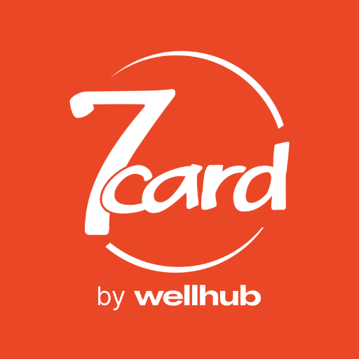
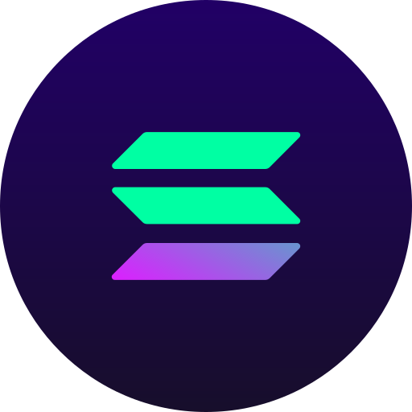

Ask & Call to action
Future Collaboration
🏋️‍♂️ Fitness Gyms:WorldClass, 7Card, FitZone — offer direct movement-based rewards.
👟 Eco & Sports Brands: Adidas, Decathlon, Nike — GG tokens as discounts or vouchers.
🔋 Green Energy & Tech Companies: Enel X, piezoelectric/solar startups — integrate energy harvesting data.
🌱 Environmental NGOs & Initiatives: For education, gamified health, and climate awareness campaigns.
📱 Solana Phone (Saga): Native Web3 app integration — strong interest from crypto investors.
🧑‍🎓 Universities / Smart Cities: Pilot urban mobility and health-based reward systems.
GreenGait
06
Notes:
Superteam Deck Notes: Put your startup name and logo with a 1-line subtitle.
This subtitle should be a game changer - it focuses on outcomes and the secret sauce.
(eg. “Decentraland - a virtual world owned by its users”)

Slide 22
Ask & Call to action
G
R
E
E
N
Contact Us
Whether you're an investor, an early user, or a passionate builder —we’d love to have you on the GreenGait journey.
📩 Email: robert.v.panta@gmail.com
🌐 GitHub: github.com/RobCyberLab
📱 LinkedIn: linkedin.com/in/robert-panta
G
A
I
T
Move to earn, live to sustain
powered by motion, secured by blockchain
GreenGait
06
Notes:
Superteam Deck Notes: Put your startup name and logo with a 1-line subtitle.
This subtitle should be a game changer - it focuses on outcomes and the secret sauce.
(eg. “Decentraland - a virtual world owned by its users”)

Slide 23
G
E
N
R
E
G
I
A
T
Notes:
Superteam Deck Notes: Put your startup name and logo with a 1-line subtitle.
This subtitle should be a game changer - it focuses on outcomes and the secret sauce.
(eg. “Decentraland - a virtual world owned by its users”)

